Slide 1

M4 - Video Analysis
Block 4. Optical Flow. Video Stabilization
Adrià Ciurana
Guim Perarnau
Pau Riba

Slide 2
Task 1: Block Matching
Implementation choices:
Compensation: Forward
Area of search: 16x16 pixels
Size of the blocks: 48x48 pixels
Very slow. For task 3, we have used a buit-in function (Matlab BlockMatcher), which is much faster.

Slide 3
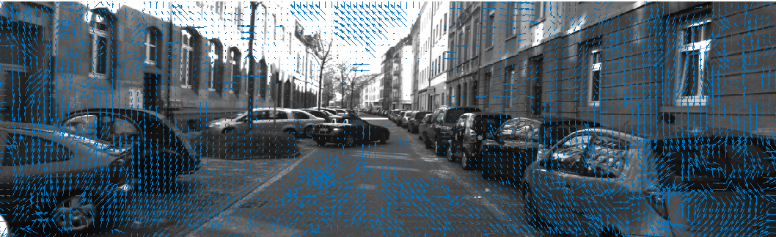
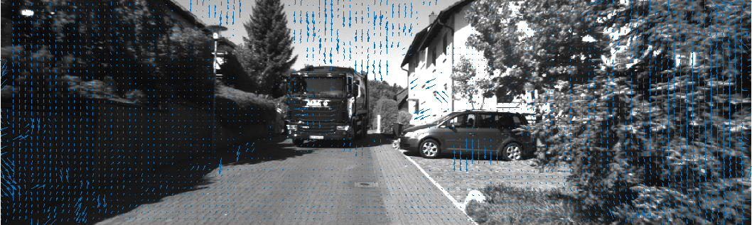
Task 1: Block Matching

Slide 4
Task 2: Comparison with Lucas-Kanade
Lucas-Kanade is already implemented in MATLAB.
Evaluation in terms of:
Mean Magnitude Error (MMEN)
Percentage of Erroneous Pixels (PEPN).
Threshold 3.
000045_10 | MMEN | PEPN (%)
Block matching (forward) | 15.300 | 84.091
Lucas-Kanade | 10.627 | 78.560
Average | MMEN | PEPN (%)
Block matching (forward) | 9.723 | 67.065
Lucas-Kanade | 6.689 | 56.304
000157_10 | MMEN | PEPN (%)
Block matching (forward) | 4.145 | 50.038
Lucas-Kanade | 2.750 | 34.048
Notes:
000045_10 Block matching (backward) 14.781 83.175
000157_10 Block matching (backward) 4.134 50.263
Average Block matching (backward) 9.457 66.719

Slide 5
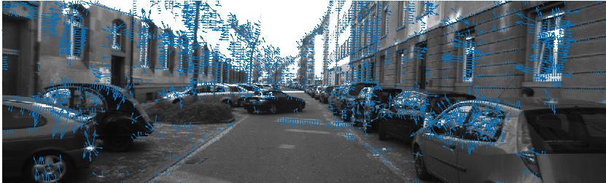
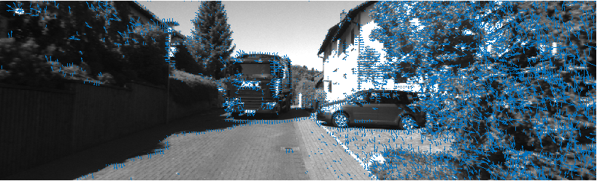
Task 2: Comparison with Lucas-Kanade
Lucas-Kanade provides a more accurate result than Block Matching. Instead of dividing the image using blocks, L-K allows each pixel to have his own direction using the Taylor approximation.
For the Block Matching algorithm, the block division is a very important step. There can happen that pixels that are moving in different directions fall in the same block. Hence, the estimated flow will not be correct.
Examples of Lucas-Kanade optical flow

Slide 6


Task 3: Stabilization
We propose the following algorithm:
Read the video sequence.
Estimate the optical flow for the full video*.
All frames of the sequence (except for the first) will be based on the first frame as reference. In other words, all frames will we mapped to the first one:
Get the mode of vectors Vx and Vy (extracted from the optical flow)
Apply the translation vector using a scale-rotate-translate matrix (tform MATLAB object):
Complete the missing information with the previous frame.
Apply the same transformation to the ground truth in order to correctly evaluate the segmentation
We have made the assumption that most of the image is background where there is a foreground object that moves independently. Hence, we have applied a translation on the most common vector of our image.
where M¹_{i} is the transformation matrix that maps frame i to frame 1 and M¹₀ is the identity matrix.
*Optical Flow estimated using Block Matcher provided by Matlab.

Slide 7
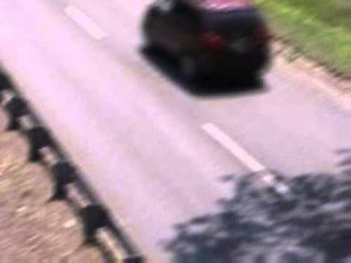
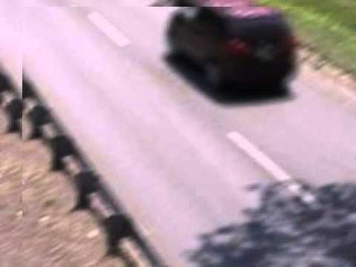
Task 3: Stabilization
Original
Stabilized
In these video we can see how the stabilized video is correctly stabilized at the beginning. However, in the lasts frames the jittering increases and the block matching optical flow is unable to eliminate it completely.

Slide 8
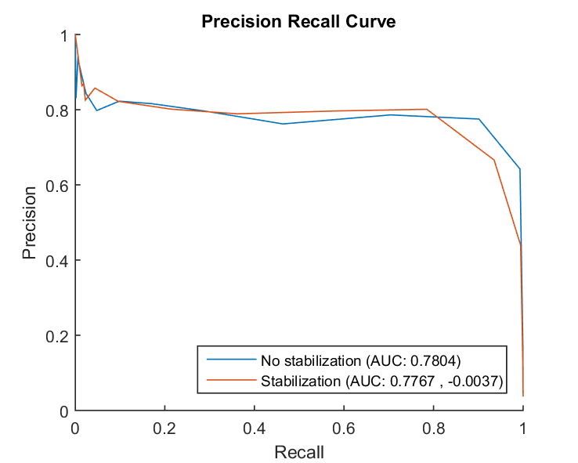
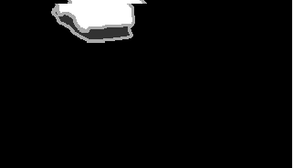
Task 3: Stabilization
(Note: to check the results we obtained in the previous block 3, click here.)
The results for stabilizing the video are not better than the jitter version. We think this is caused by two reasons:
1. The jitter didn’t affect much the unstabilized video. Remember that we are comparing with the best segmentation from 3, which uses adaptive Gaussian segmentation and therefore can adapt to jitter.
2. The stabilization is not perfect and it adds noise, as it can be seen in the previous slide. The ground truth is also stabilized, so there’s is noise there, too.
Example of noise in ground truth.
Best F1-Score (no stabilization): 0.8336
Best F1-Score (stabilization): 0.7930

Slide 9
Task 4: Optical Flow
Average | Mean Magnitude Error (MMEN) | Percentage of Erroneous Pixels (PEPN)
Sun et al. [1] | 0.2568 | 1.73
Barron et al. [2] | 4.1863 | 51.82
The ground truth provided by this dataset is only for two of the images of the sequence.
On one hand, we notice that the proposed technique by Sun et al. overperforms the other techniques. This method claims to be ranked #1 on the Middlebury evaluation as of June 2010. Hence, it is logic that it gets the best metrics.
On the other hand, Barron et al. is an optical flow proposed more than 20 years ago and as it is expected lack to compute an accurate result.
[1] Secrets of optical flow estimation and their principles Sun, D., Roth, S., and Black, M. J., IEEE Conf. on Computer Vision and Pattern Recog., CVPR, June 2010.
[2] Barron, J. L., D. J. Fleet, S. S. Beauchemin, and T. A. Burkitt. "Performance of optical flow techniques". CVPR, 1992.

Slide 10
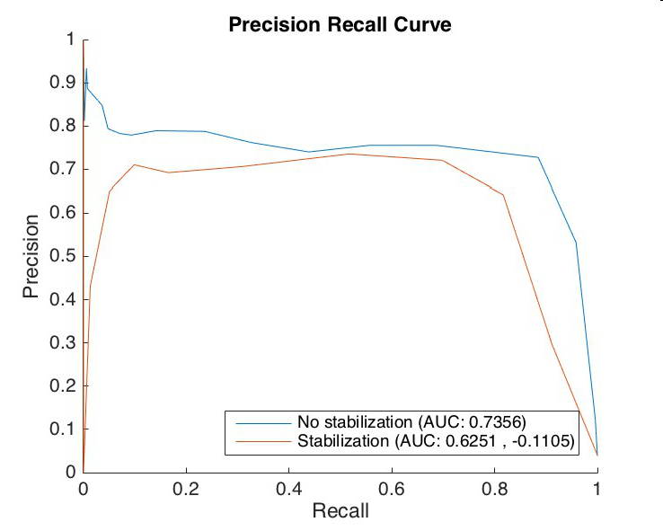
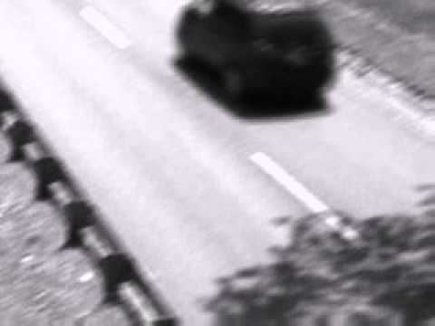
Task 5: Additional Stabilization
Stabilization based on target location [3].
Manually select a target region of interest (ROI) in the first frame and define an area search.
Find corresponding ROI in next frame.
Estimate transformation between both ROIs.
Best F1-Score (no stabilization): 0.7984
Best F1-Score (stabilization): 0.7190
This stabilization worse the results because is hard to find a unique ROI in the traffic sequence due to most of the scene being homogenous or having repeated patterns. Therefore, the algorithm is unable to accurately find the selected ROI of frame t in frame t+1, which has a huge negative impact on the performance of the stabilization.
Also, this algorithm is more focused on tracking a specific object rather than stabilization. If in the sequence were to be a stable object to track, this algorithm could have given better results.
[3] Code based on this MATLAB example.

Slide 11
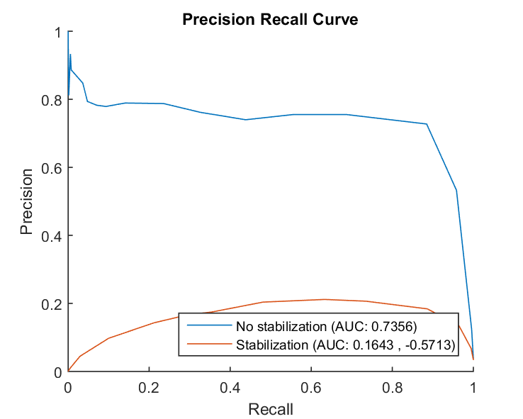
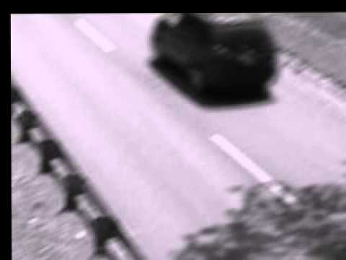
Task 5: Additional Stabilization
Stabilization based on features matching + M-estimator SAmple Consensus (MSAC) [4].
Find feature points on both images (SURF detector used in our case).
Pair key points.
Use MSAC (RANSAC like algorithm) to eliminate outliers.
Estimate transformation between images.
Best F1-Score (no stabilization): 0.7984
Best F1-Score (stabilization): 0.3223
The results are low because the feature points detected are the ones belonging to foreground (moving cars). That means that the motion estimation is incorrectly stabilizing the movement of the cars rather than the jittering of the camera, making the stabilization a complete failure.
[4] Code based on this MATLAB example.

Slide 12
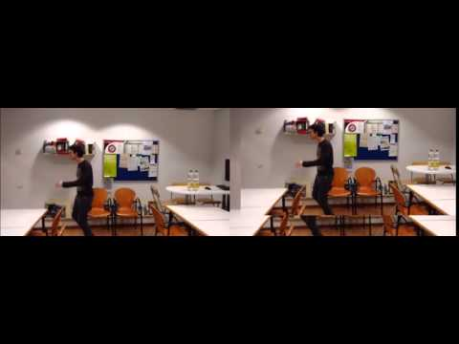
Task 6: Own Record
The proposed video is a very hard example to apply video stabilization. First of all, the camera has an extremely exaggerated jitter that can bring to errors of our technique. Moreover, the camera tries to follow a little the foreground person. Hence, it is not a perfect problem of a fixed camera with a jitter produced by the wind.
Original video
Stabilized video
Method for stabilization: MATLAB block matching (same used in Task 3)

